Slide 1

Flight Ticket Booking System
A Python-based system for booking flight tickets.
Prepared by
Jay Vasoya

Slide 2
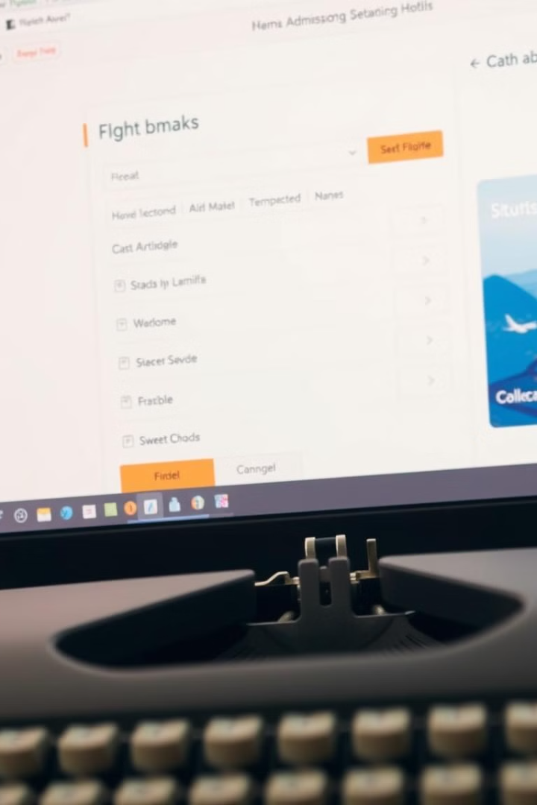
System Objectives
Simplify flight ticket booking for users.
Enable admins to manage flights efficiently.
1
User-Friendly
Easy flight ticket booking.
2
Efficient Admin
Streamlined flight management.

Slide 3





User Functionalities
Users can search, book, and cancel flights.
They can also view their booking history.
Search Flights
Book Tickets
View History
Find available flights.
Check past bookings.
Cancel Tickets
Manage your bookings.

Slide 4





Admin Functionalities
Admins can add, remove, and update flights.
They can also manage user bookings.
Add Flights
Create new flight schedules.
Remove Flights
Delete existing flights.
Update Details
Modify flight information.
Manage Bookings
Oversee user reservations.

Slide 5

Database Integration
Flight details are securely stored.
User bookings are also securely stored.
Transaction records are securely kept.
Flight Details
User Bookings
Comprehensive flight information.
Secure reservation records.
Transaction Records
Detailed transaction history.

Slide 6

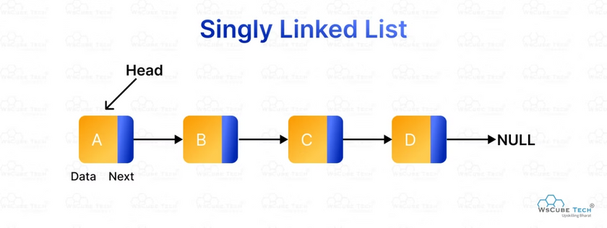
Data Structure
A linked list manages flight schedules.
This allows dynamic data handling.
Dynamic
1
Efficient updates.
Scalable
2
Easily expandable.
Flexible
3
Adaptable schedules.

Slide 7



Technology Stack
Python programming language.
MySQL for database management.
Linked list for data handling.
2
MySQL
Database storage.
Python
1
Core programming.
Linked List
3
Data management.

Slide 8
Merits and Demerits
Merits
Demerits
Efficient booking process.
Requires technical expertise.
Secure data storage.
Maintenance overhead.
Dynamic flight management.
Potential security risks.

Slide 9

Future Scope & Conclusion
A scalable and efficient system.
Ensures seamless travel experiences.
Scalability
Future growth potential.
Efficiency
Optimized performance.
Seamless Travel
Enhanced user experience.

Slide 10

Thank You

